Slide 1


Slide 2

Announcements
Memberships
CTF Club
Hack The Box Practice CTF for Beginners
Hack The Box University CTF Competition
Christmas Meal
Notes:
https://ctf.hackthebox.com/event/details/hack-the-boo-2024-practice-1811

Slide 3
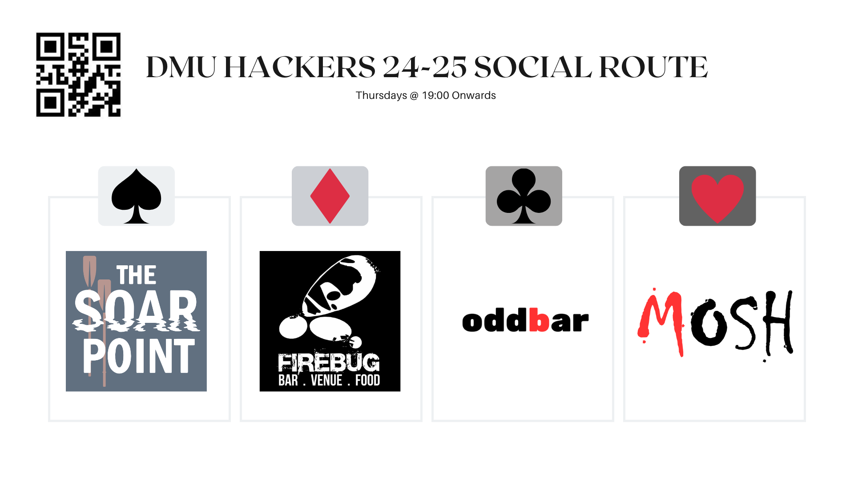
Notes:
Firebug student discount is all week and not just when we go out as a society

Slide 4
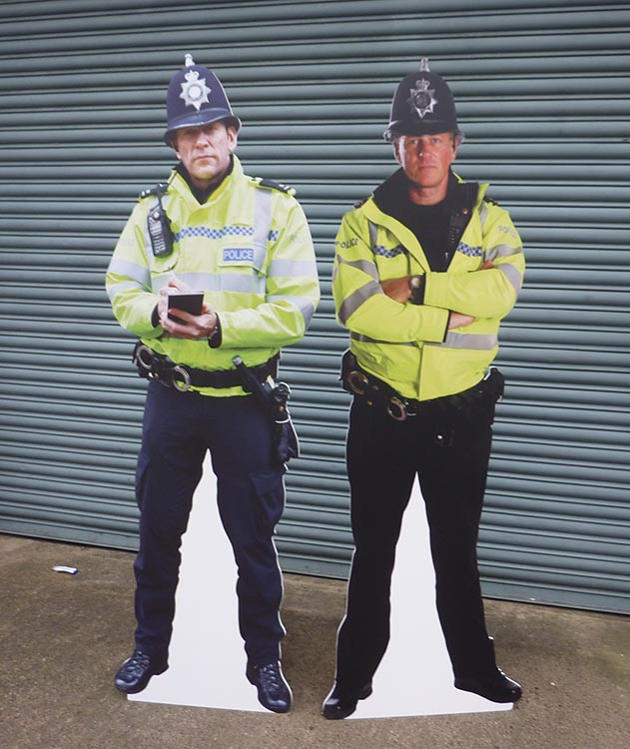


D0n’t D0 ill3gal Sh1t !

Slide 5
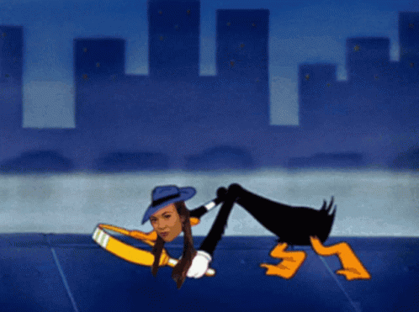
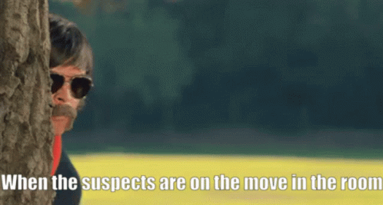

What is OSINT ?
“Open-source intelligence (OSINT) is the process of gathering and analyzing publicly available information to assess threats, make decisions or answer specific questions.”
Collect
Protect
Analyse
Verify
Report

Slide 6






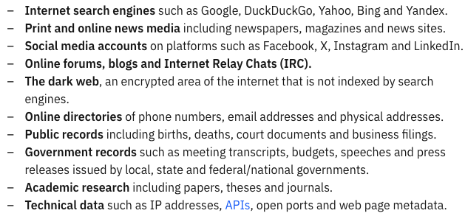






Sources of Data

Slide 7

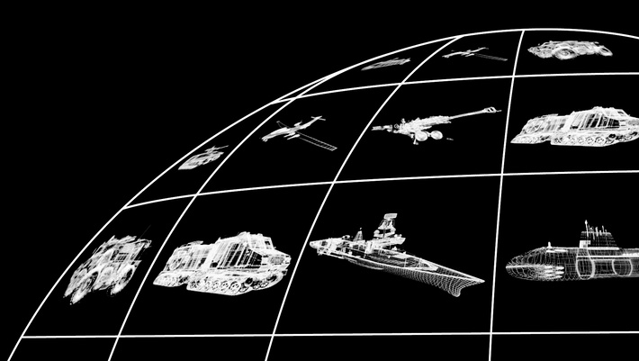








A (not) sponsored ad break ;)

Slide 8

Careers in OSINT and Intelligence

Slide 9
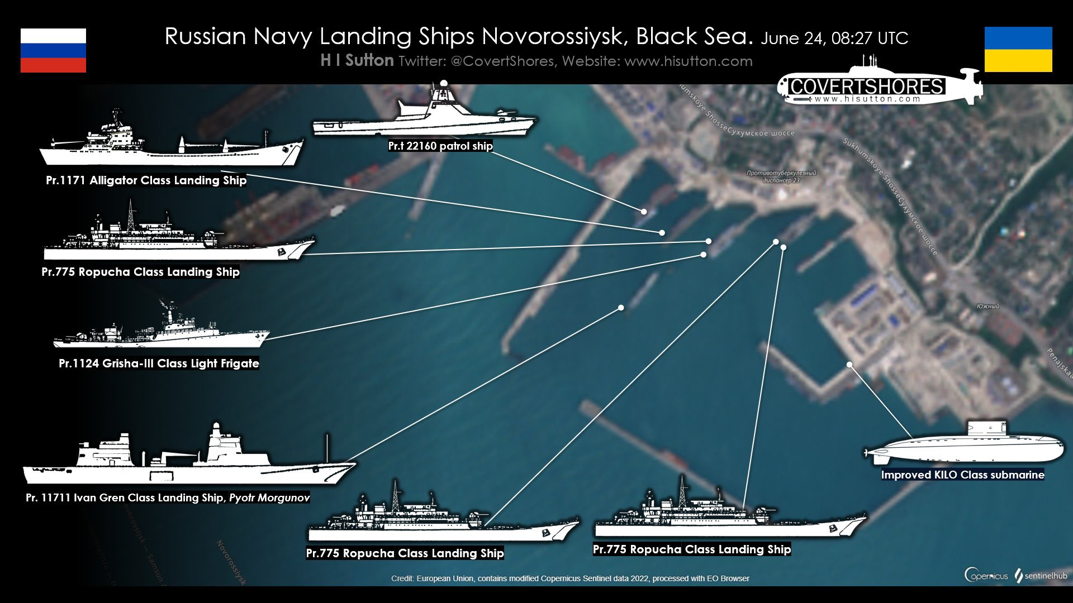
Careers in OSINT and Intelligence

Slide 10
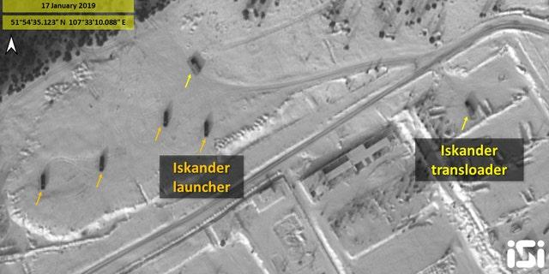
Careers in OSINT and Intelligence

Slide 11
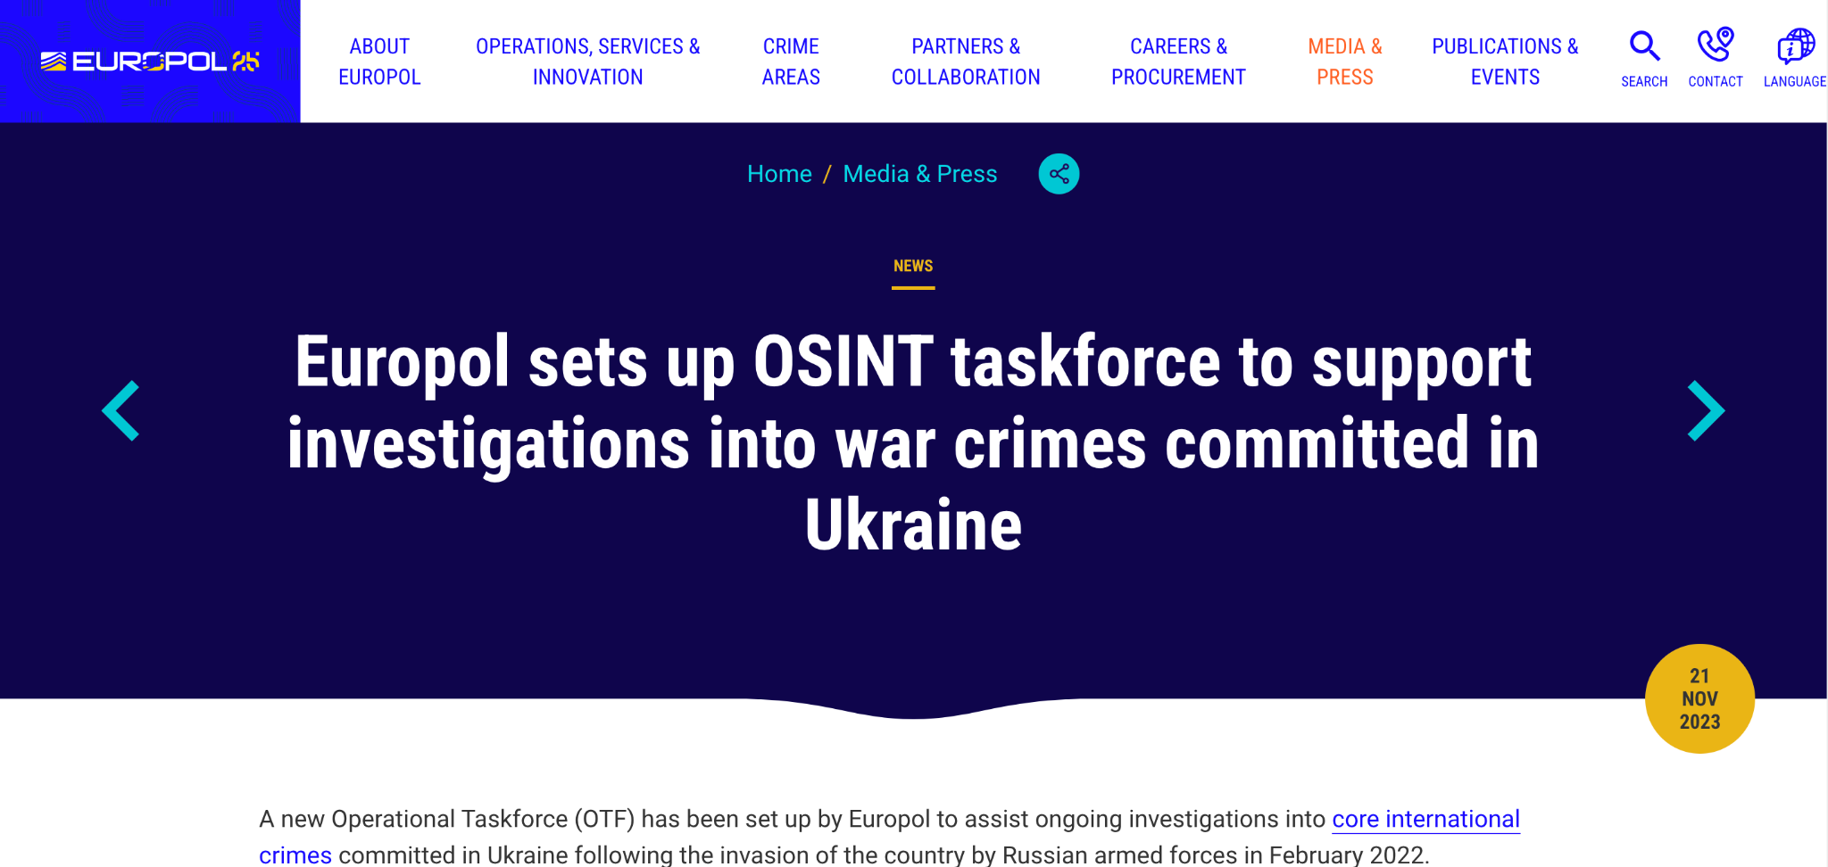
Careers in OSINT and Intelligence

Slide 12
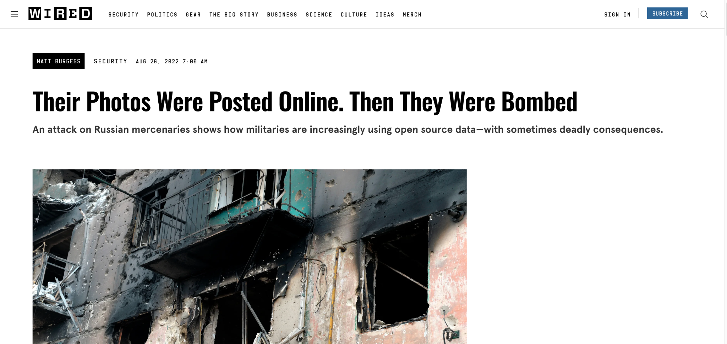
Careers in OSINT and Intelligence

Slide 13
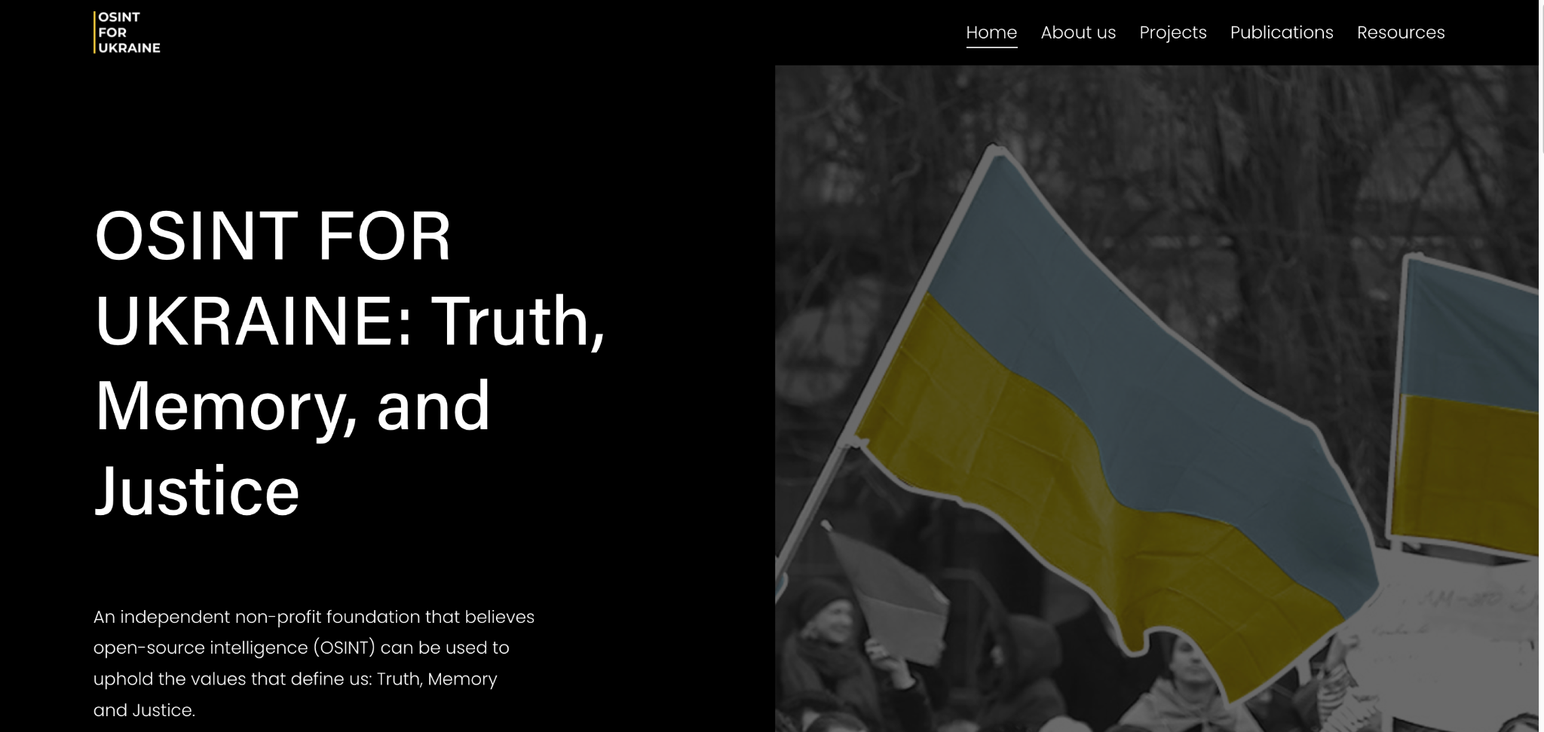
Careers in OSINT and Intelligence

Slide 14
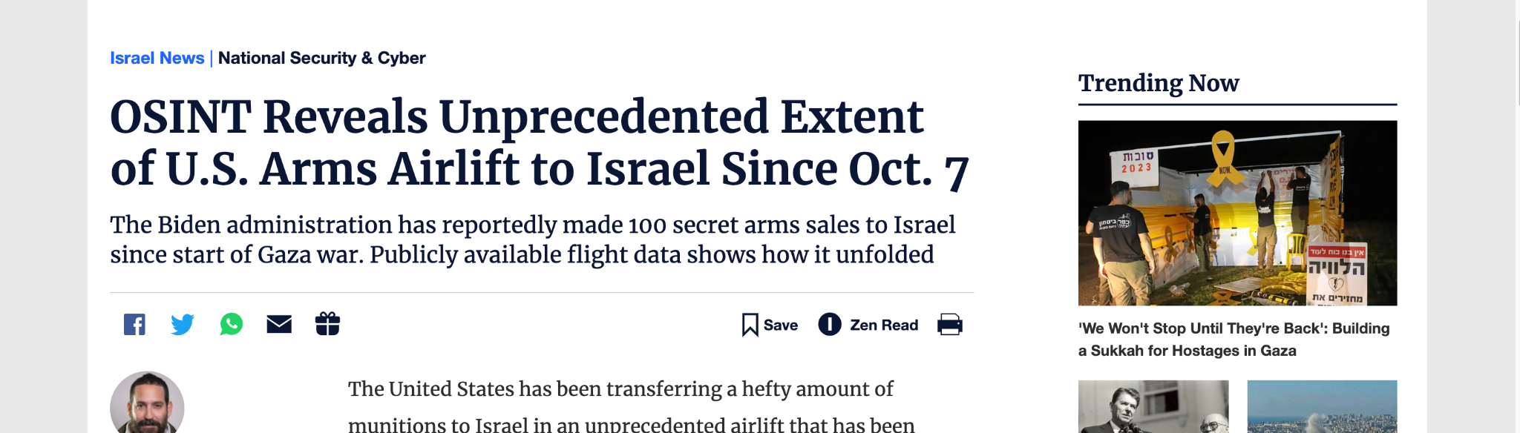
Careers in OSINT and Intelligence

Slide 15
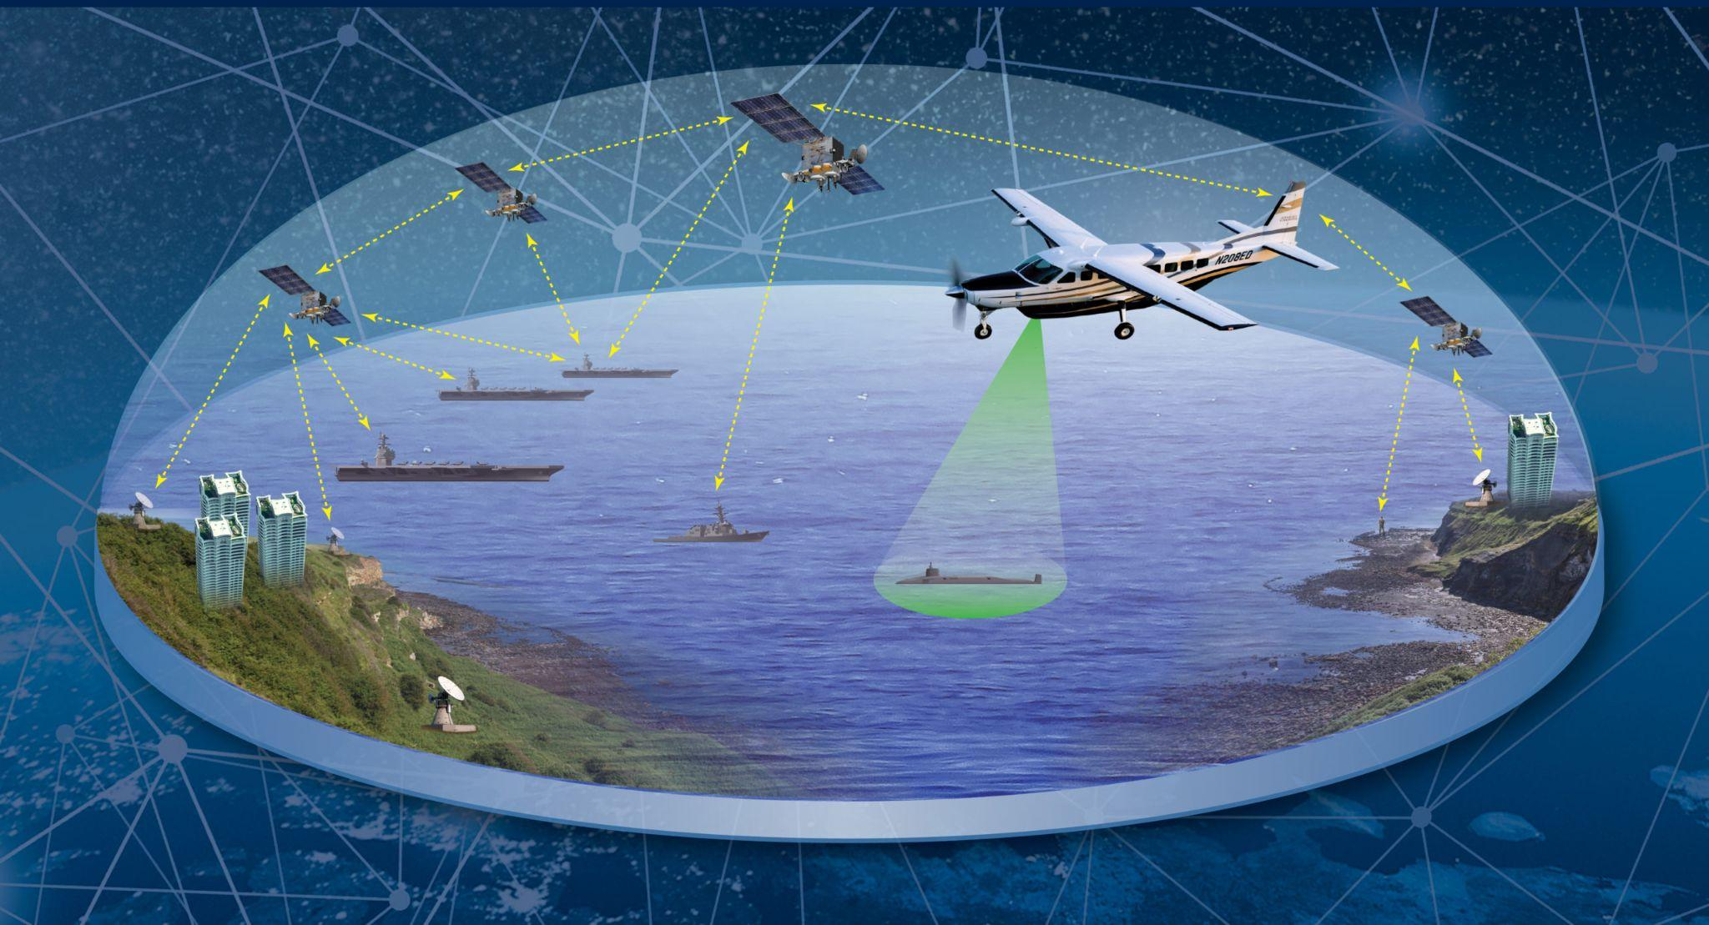
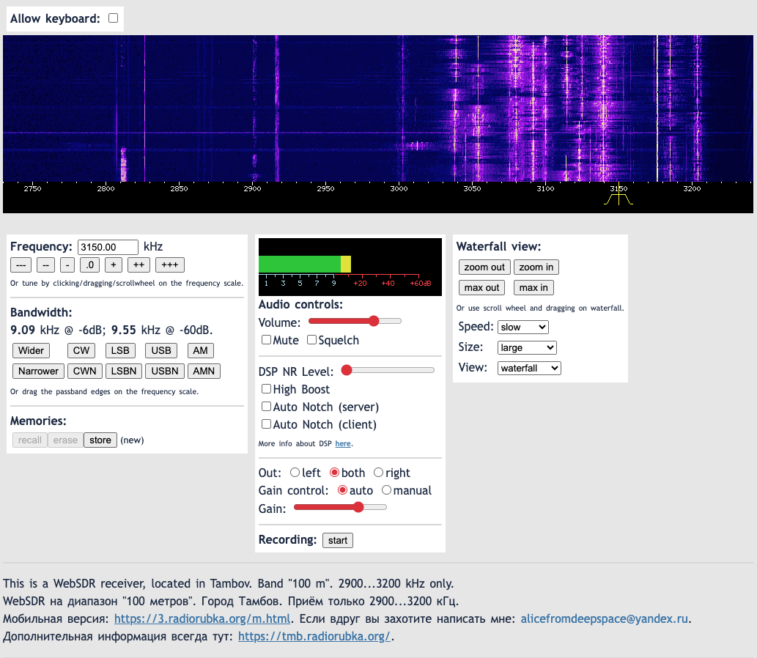
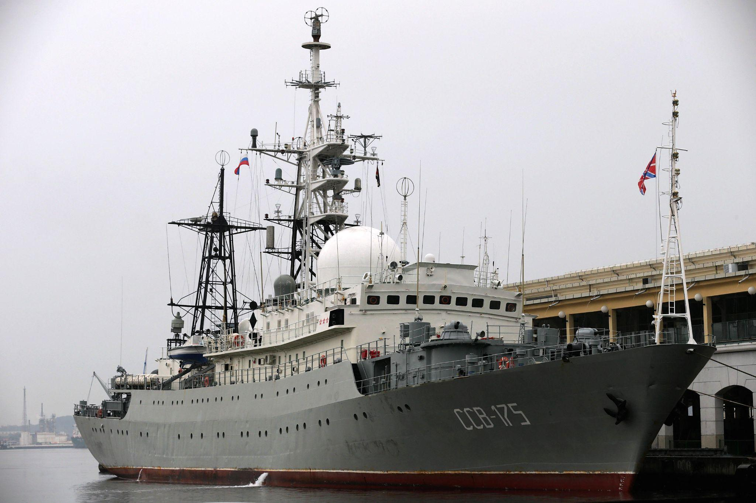
SIGINT
Signals Intelligence
Russian Surveillance Ship viktor-leonov
Naughty Naughty !
TACNET - A military battlespace technology to synchronise ground units and vehicles to share data
One location to mark out every piece of equipment and every soldiers position in real time !! what a great idea - NOT
/http://sdr.r9a.ru/
A popular web interface to publicly accessible RTL-SDR receivers

Slide 16

HUMINT
Human Intelligence
No comment… Do your research

Slide 17
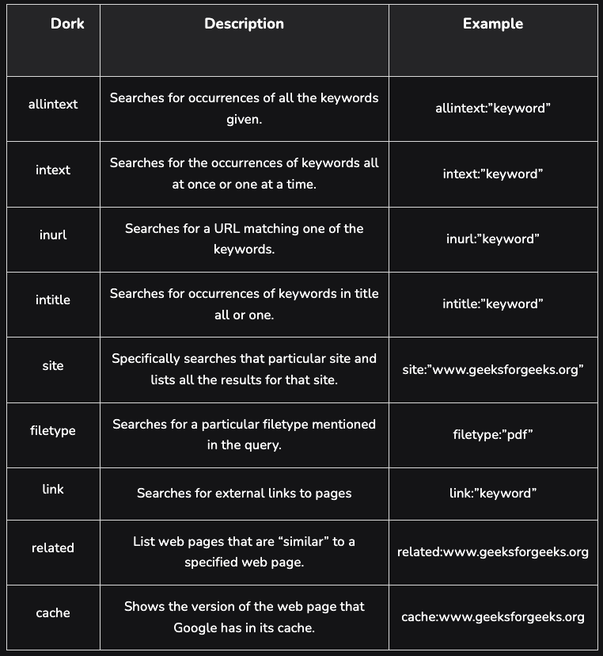
Google Dorking

Slide 18
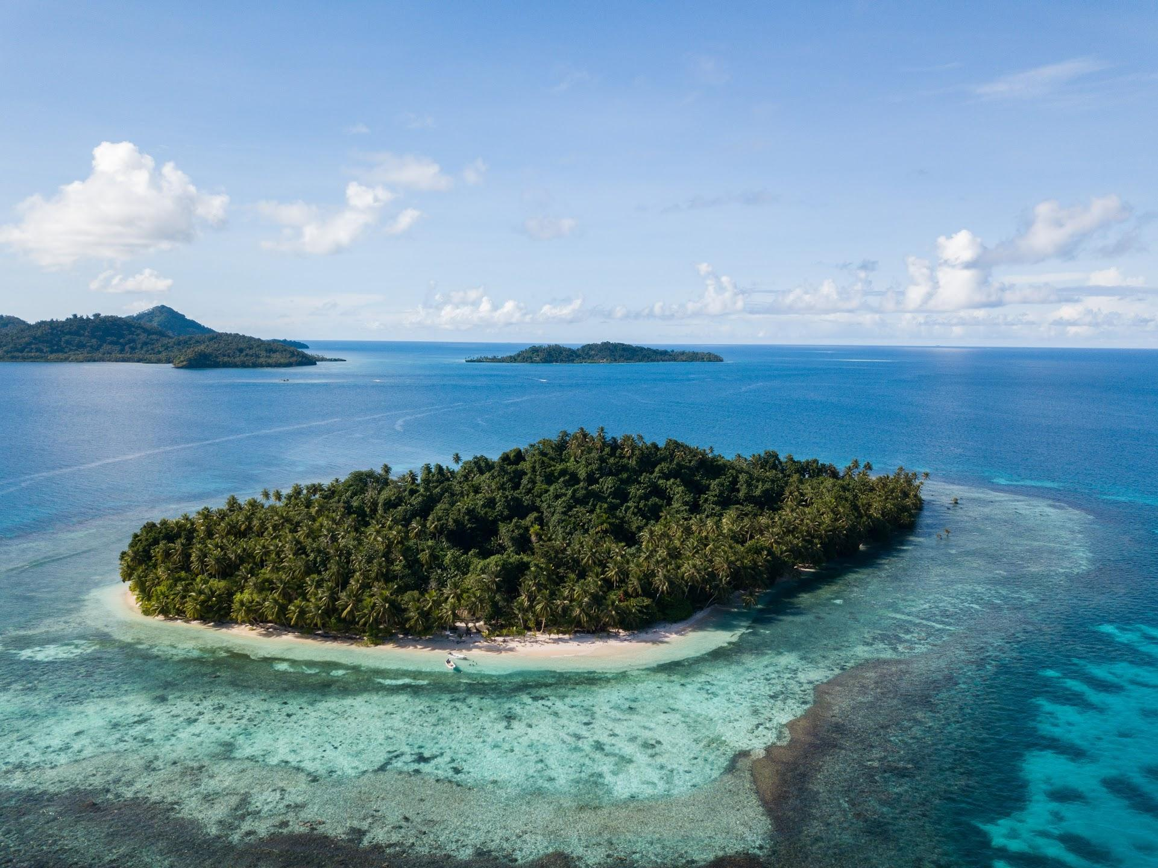
OSINT Exercise 1 - Imagery
Task briefing:
This is a photo of a resort located on an island.
a) What is the name of the resort?
b) What are the coordinates of the island?
c) In which cardinal direction was the camera facing when the photo was taken?

Slide 19
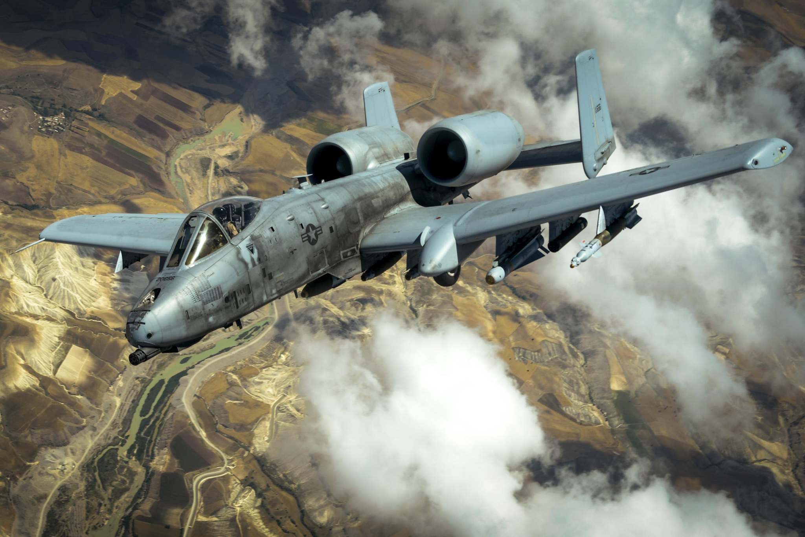
OSINT Exercise 2 - Imagery
Task briefing:
On November 25, 2020, a Twitter user shared the photo below.
It depicted a military aircraft flying over an “undisclosed location”.
Your task is to disclose that location.

Slide 20
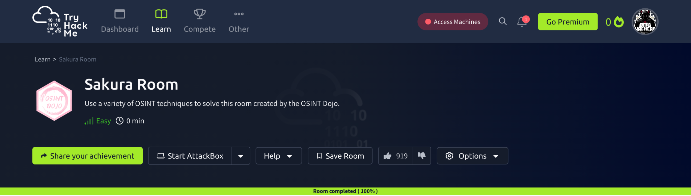
TryHackMe - Sakura :)
https://tryhackme.com/r/room/sakura
NOTE: All answers can be obtained via passive OSINT techniques, DO NOT attempt any active techniques such as reaching out to account owners, password resets, etc to solve these challenges.

Slide 21
Tools to consider:
01
What’s My Name
Username Search by username
WhatsMyName.app
02
gpg --import <.asc>
Working with GPG keys
Capture credentials of the author
Kali terminal !
03
Search the web !!
Find OPSEC mistakes !
Use all the details you have acquired
Hint: Social Media accounts ?
04
Cryptocurrency Lookup tools
Find transaction history etc
05
Reverse Image Search
Use images to see where they appear on the web
Find social media accounts

Slide 22
TryHackMe - Sakura :)
https://tryhackme.com/r/room/sakura
01000001 00100000 01110000 01101001 01100011 01110100 01110101 01110010 01100101 00100000 01101001 01110011 00100000 01110111 01101111 01110010 01110100 01101000 00100000 00110001 00110000 00110000 00110000 00100000 01110111 01101111 01110010 01100100 01110011 00100000 01100010 01110101 01110100 00100000 01101101 01100101 01110100 01100001 01100100 01100001 01110100 01100001 00100000 01101001 01110011 00100000 01110111 01101111 01110010 01110100 01101000 00100000 01100110 01100001 01110010 00100000 01101101 01101111 01110010 01100101
A picture is worth 1000 words but metadata is worth far more
Image Type: .svg
Right Click to inspect :)

Slide 23




Your turn!

